Slide 1
Power Curve Working Group
Patrick Moriarty
December 4, 2012

Slide 2
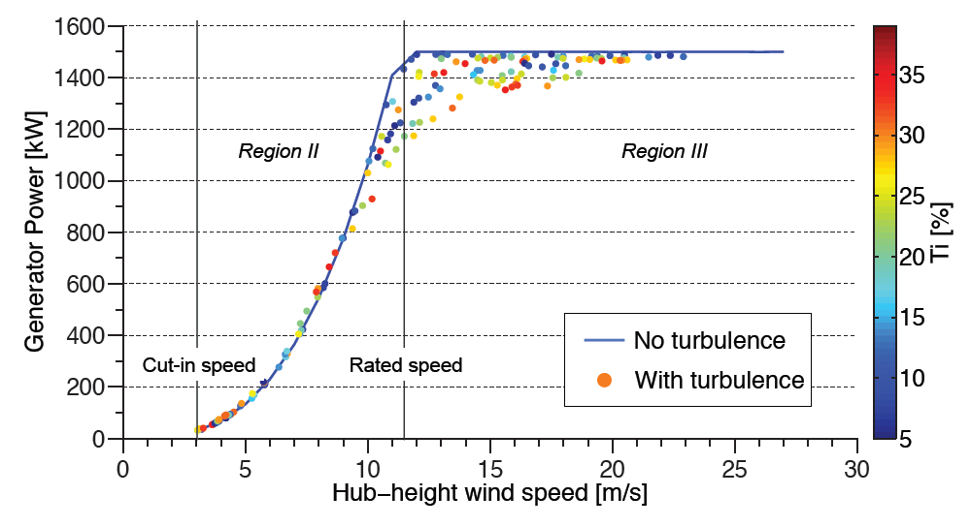
Impact of Turbulence and Shear
1.5 MW Turbine - 5% < TI < 40%, 0.15 < α < 0.25
Clifton et al. 2012

Slide 3
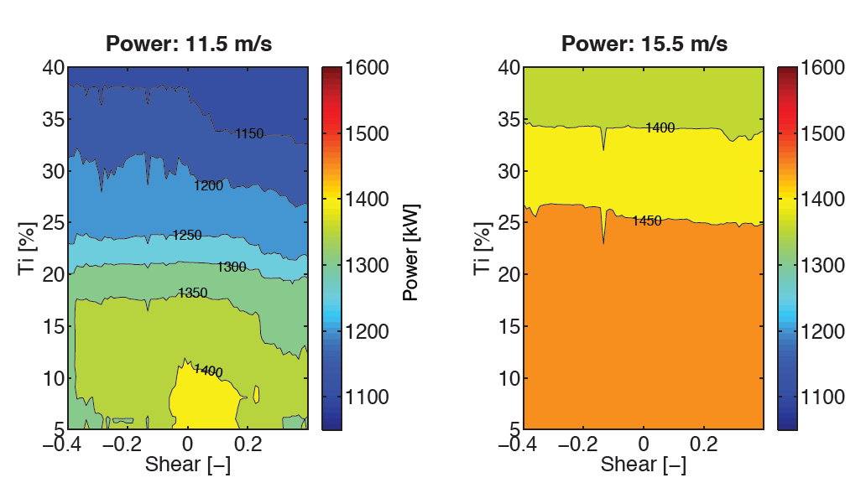
Impact of Turbulence and Shear
Turbulence dominates above rated, more complex below
Clifton et al. 2012

Slide 4
Discussion Points
How can the industry make progress on this issue?
Further analysis of highly instrumented test sites
e.g. DTU Høvsøre, ECN, NWTC, TTU
What data can be made available to community?
Identify critical variables that influence power losses (and loads)
TKE, Coherent TKE, momentum flux, veer?
What can be obtained from existing measurements and what requires new instruments?
What is uncertainty for different fidelities of measurement
Comparison of existing power curve corrections
Disk averaged vs. turbulence corrected
Weigh ease of implementation vs. improvement
Suggest public training and testing dataset(s) be created for validation of power curve correction methods

Slide 5
Discussion Points
What site specific measurements can be used to improve yields?
Turbulence intensity and shear important
May be other important/encompassing variables – engineering analysis and cost benefit analysis required
Minimum of hub height towers will multiple vertical stations
Possibly augment with remote sensing up to rotor tip for shear
What extra information can be supplied by turbine manufacturers to improve yields?
Data from highly instrumented sites to community
Faster time resolution is “free”
Some limited knowledge of control operation is required
Corrected power curves (possibly unwarranted) – will influence what measurements are needed at site
Power performance tests at more diverse set of sites

